Slide 1
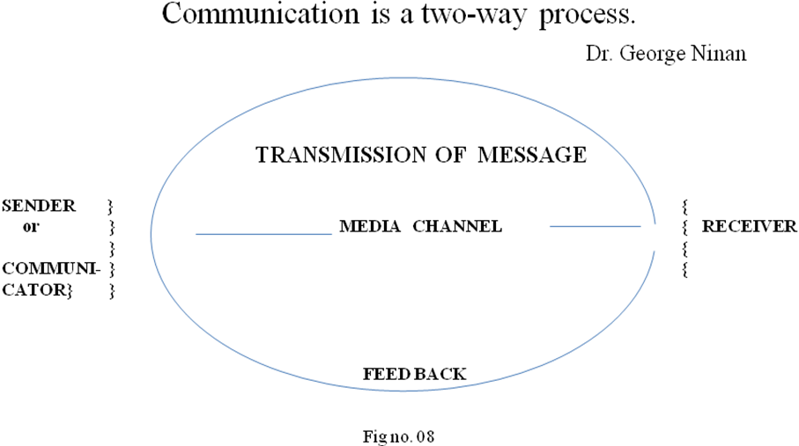
COMMUNICATION iS A tWO-WAY PROCESS

Slide 2
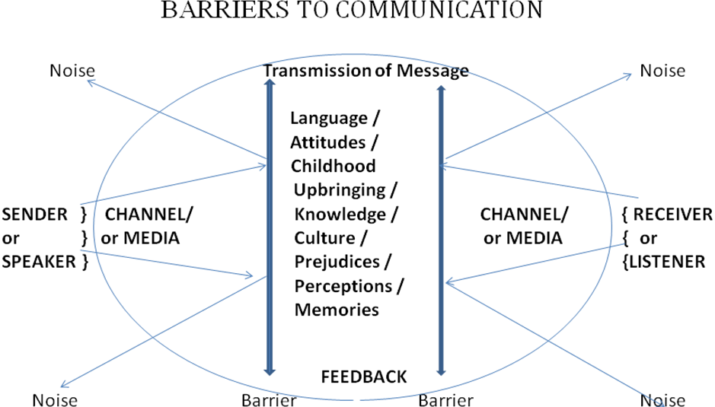
BARRIERS TO COMMUNICATION

Slide 3
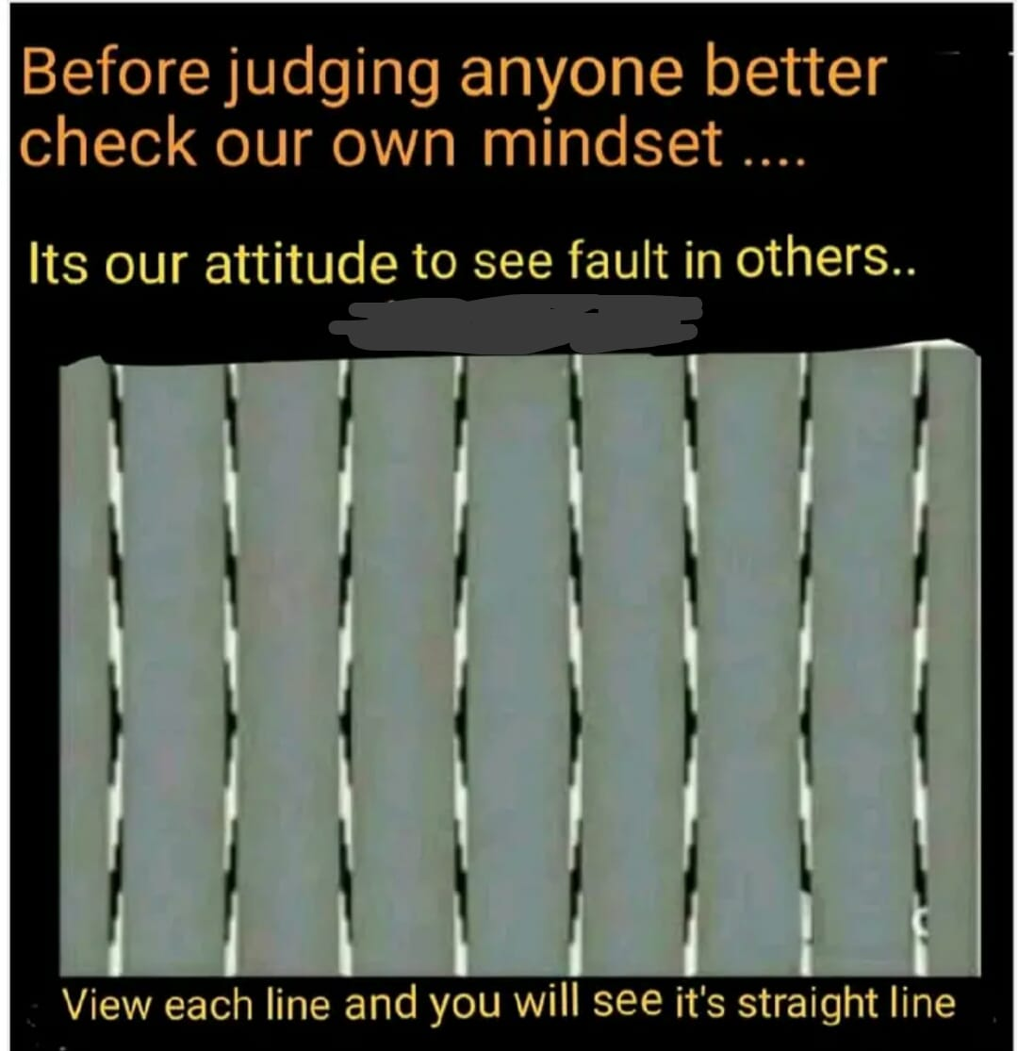
PERCEPTIONS

Slide 4
LISTENING SKILLS …..
We hear but do not listen !
Most essential skill of a Counsellor is LISTENING
75% of Counselling is Listening …
Hearing is to gain information for oneself
LISTENING is to hear beyond what the other person is trying to communicate …..
LISTEN with your heart ….
Be empathetic ….

Slide 6
GOOD LISTENER

Slide 7
LISTENING SKILLS …..
‘....... Always be prepared to give an answer to everyone who asks you to give the reason for the hope that you have. But do this with gentleness and respect, ….’1 Peter 3:15 NIV.
‘…… and always be ready to give a defense to everyone who asks you a reason for the hope that is in you, with meekness and fear; ……’
1 Peter 3 : 15 (Open Bible ).
3:15

Slide 8
Listening skills ……
‘A man (or woman ) of knowledge uses words with restraint, and a man of understanding is even-tempered’ Pro 17:27
{Especially in Grief counselling }

Slide 9
JOURNAL, DIARY & records
Details of counsellee and the case evaluation can be maintained in a journal or diary.
During subsequent sessions, the diary is of much help, as it jogs our memory about the details of the case and our analysis & assessment made.
If Counselling of those with suicidal tendencies has been carried out, the journal/diary would service as a record/evidence, in case the counsellee commits suicide….

Slide 10
Thank you !

